Slide 1
Adolf Loos
By: Javier Diaz Vicens

Slide 2
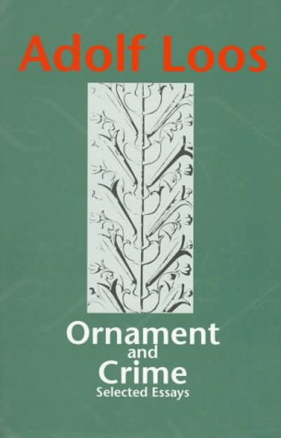
Who was Adolf Loos?
Founder of Modernist principles
Critical Theorist and writer
Architect
Ornamentation vs Function and Rationality
Ideas later seen in the work of L.C. and Mies
“Ornament is anything that cannot be justified by its rational thinking” –Loos
Economic and Utilitarian
Art Nouveau Vienna Secession

Slide 3
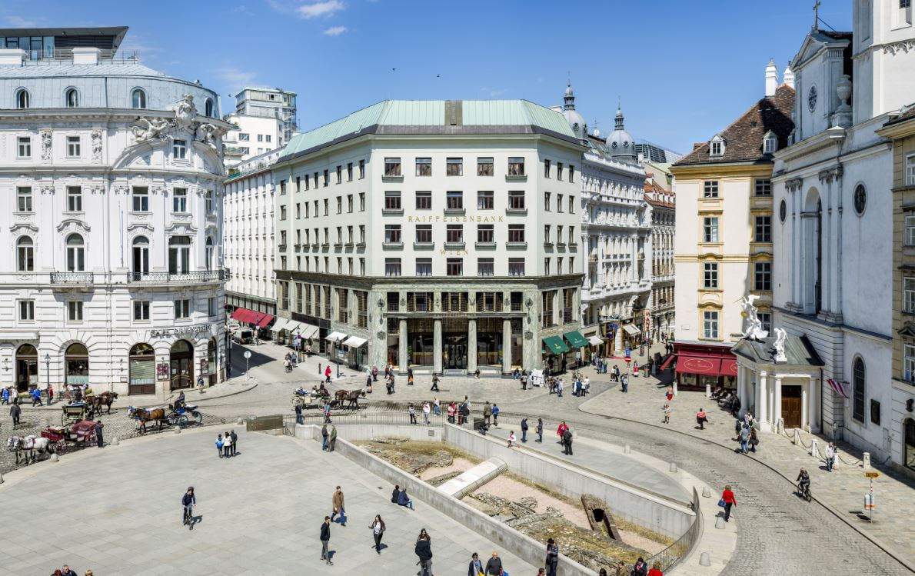
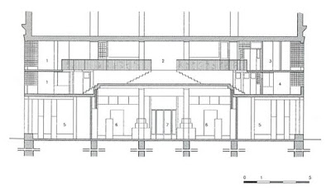
The Goldman and Salatsch Building - Vienna, Austria - 1909 – Leopold Goldman & Emanuel Alfricht
Defies classical past
Defies ornamentation
Controversial façade
Key downtown location
Statement of progression by Loos
Birth of Modern principles – Horizontality, human material, lack of ornament, structure, pure abstract form

Slide 4
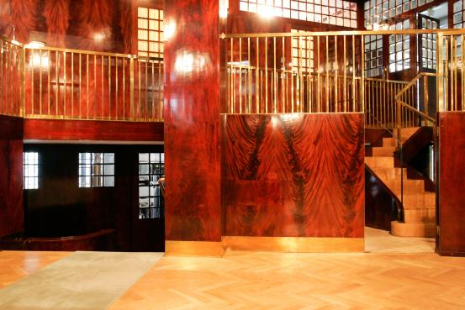
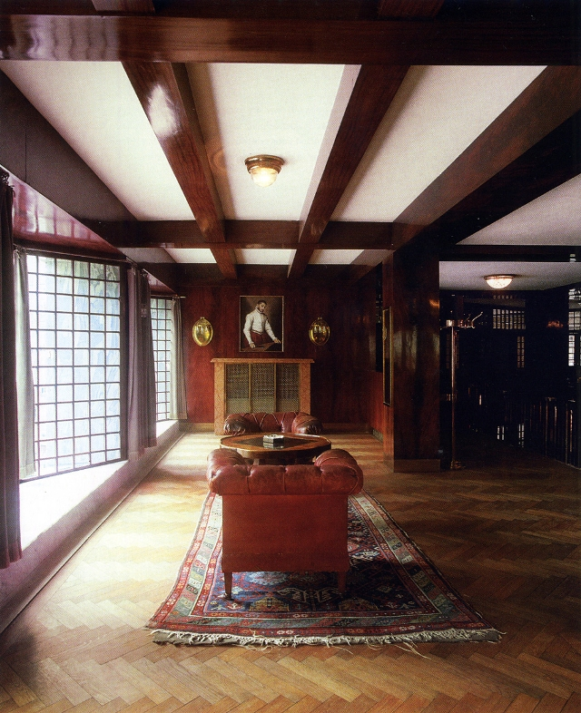
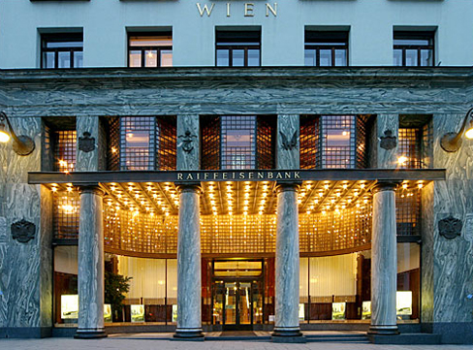
Interior
Material becomes an important change

Slide 5
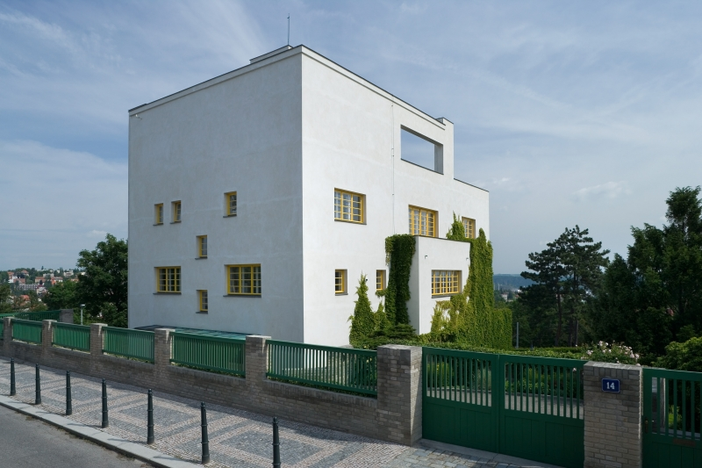
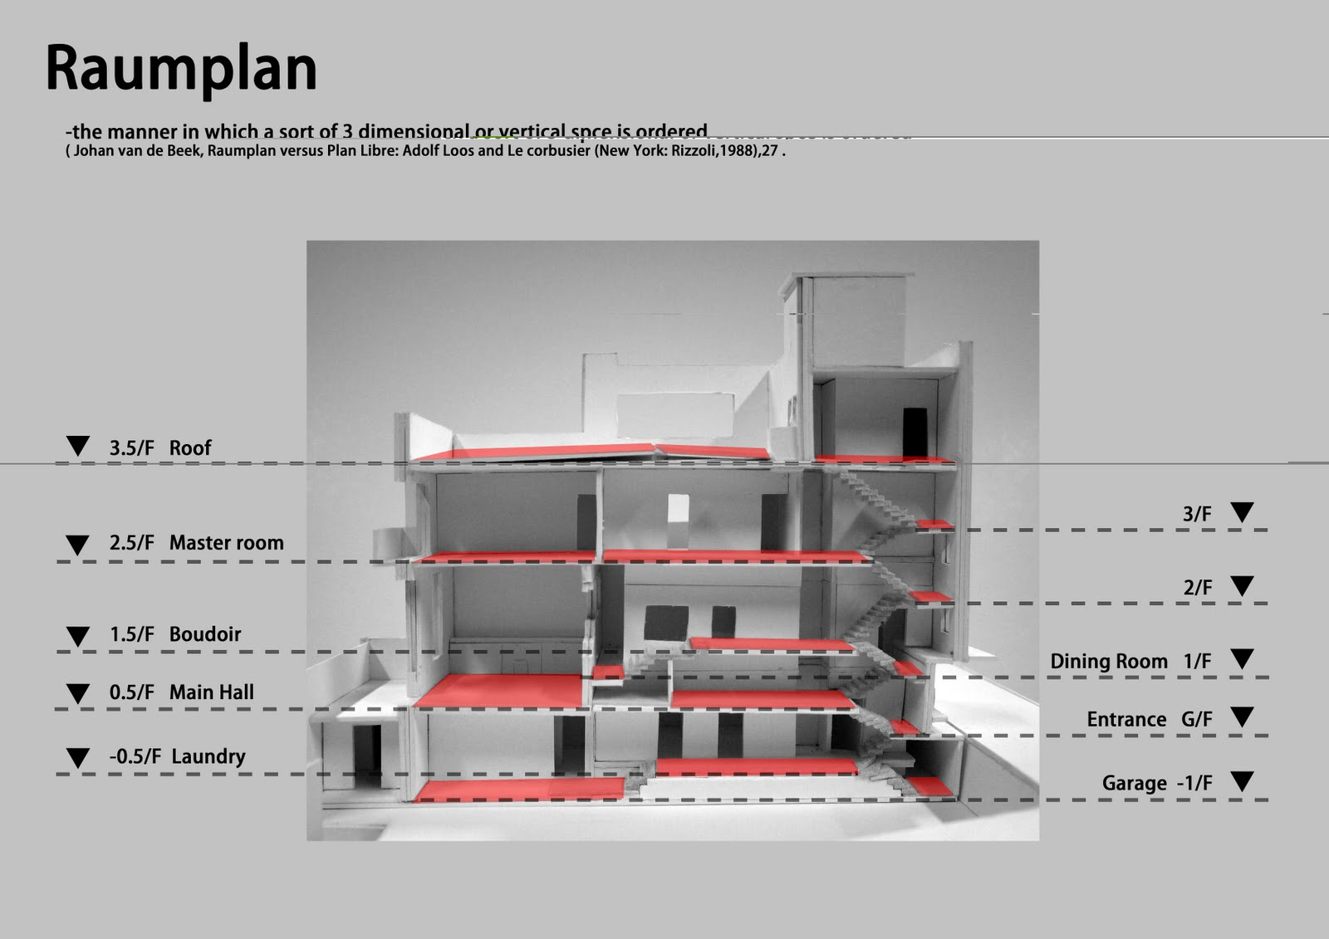
Villa Mueller – Prague, Czech Republic – 1930 – Frantisek Mueller
Most studied work
Exterior vs interior
Clear Modern principles and ideologies
organization

Slide 6
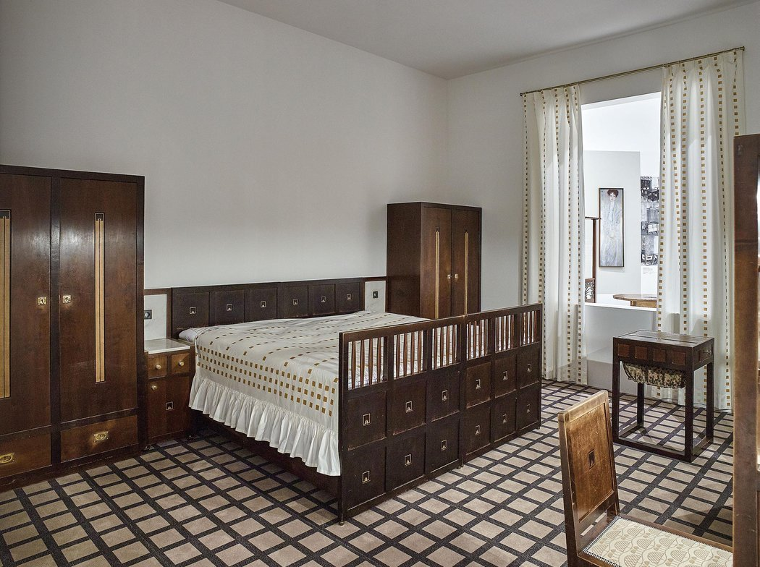
Interior
Complex use of material and furniture
“The Poor Little Rich Man”

Slide 7
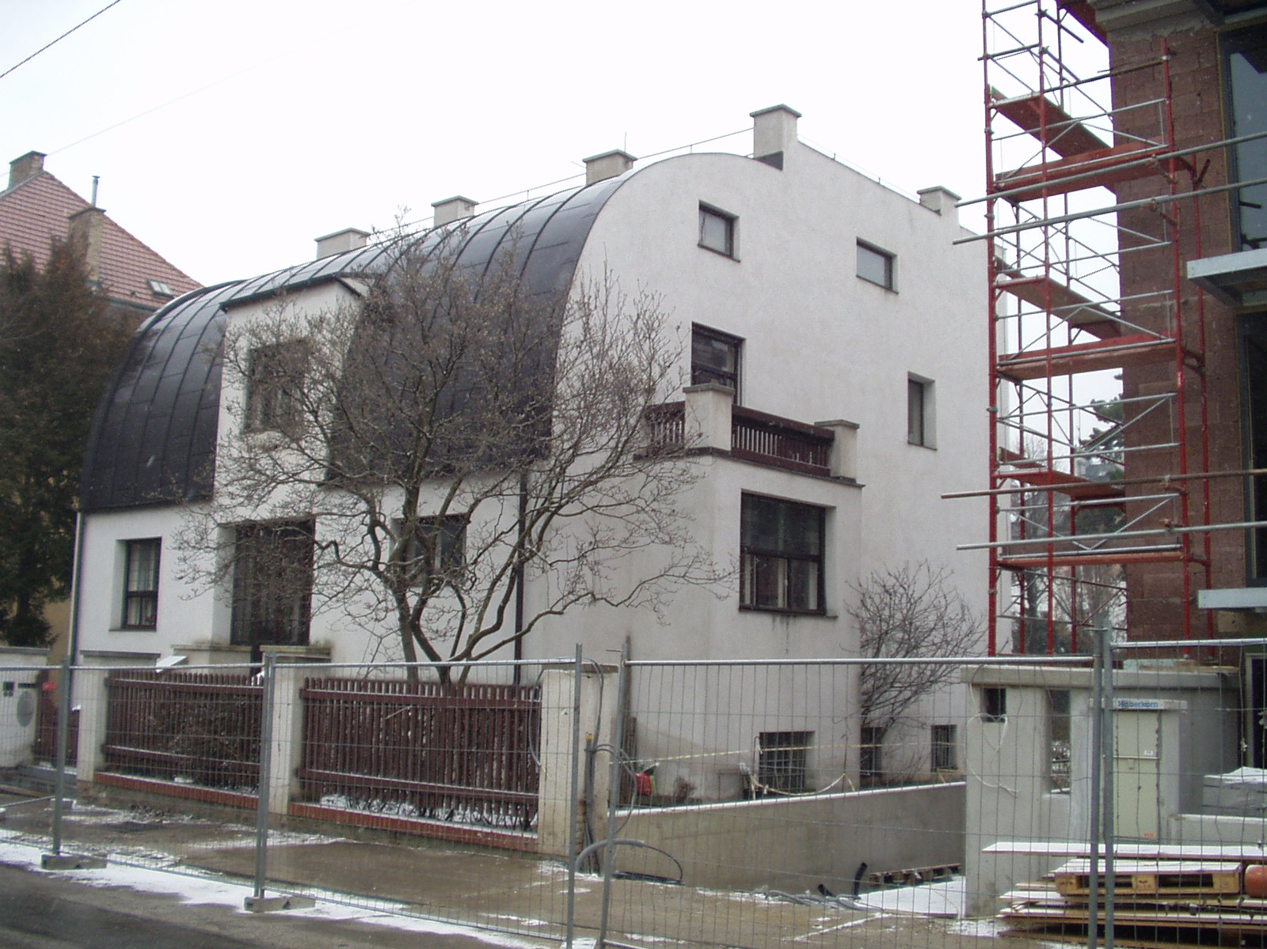
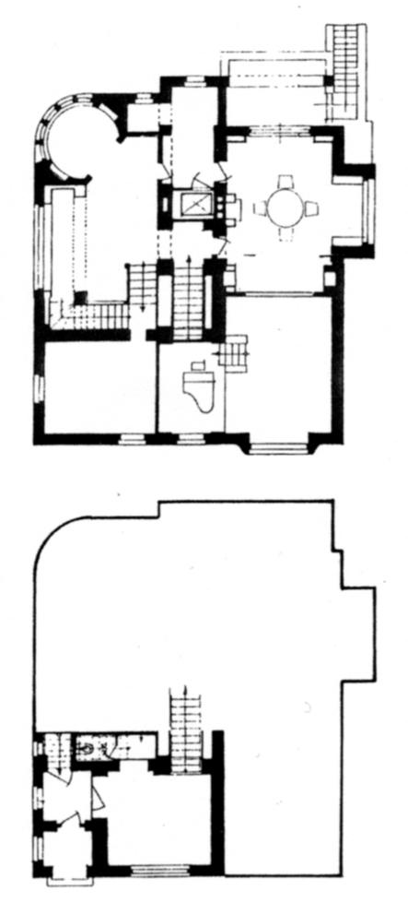
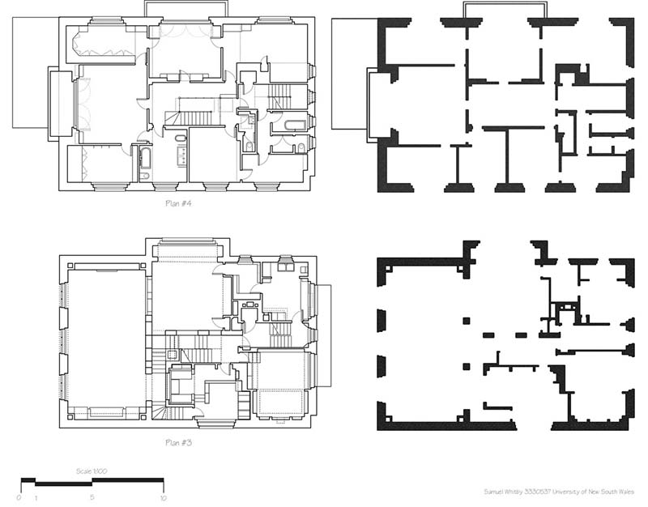
Progression of Work
This Photo by Unknown Author is licensed under CC BY-SA

Slide 8
Outside Thoughts and Influence
Movement of the new style – his roots
“Ornament and Crime is a Homeric Cleansing” –L.C.
Frank Lloyd Wright considered that loos did the work he strived for in America in Europe.
Set a foundation for “function” in Architecture
“It is necessary to obliterate ornament in order to have modern culture exist and evolve beyond the past” –Adolf Loos

